Slide 1

STU1900117
IMEAR COMBI-HEADLAMP
FULL LED 24 V
REV | Date | Mod.
00 | 22/07/19 | First issue

Slide 2
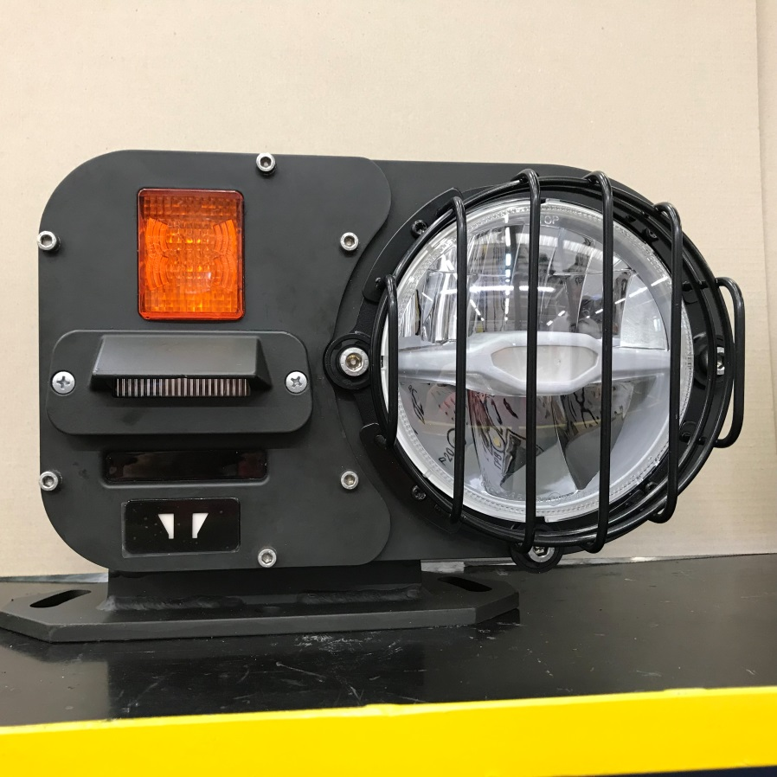
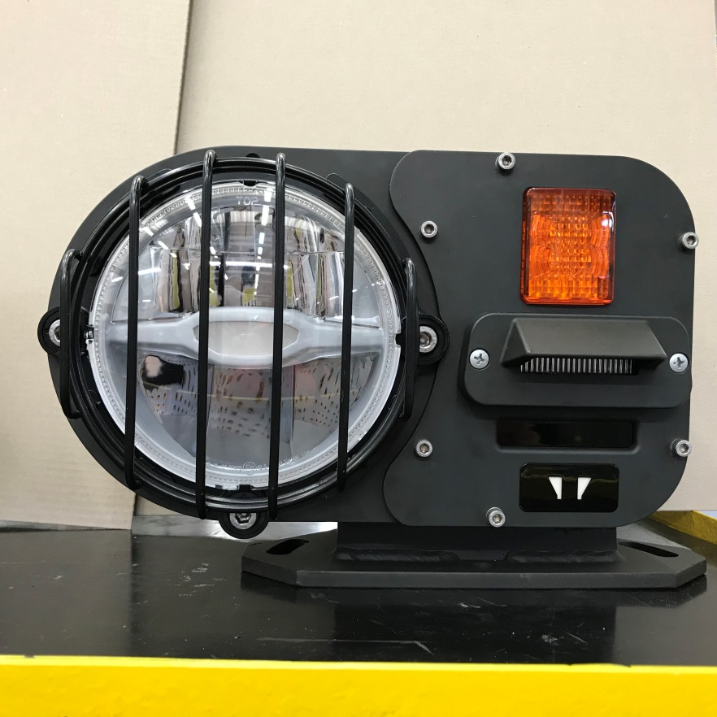
FRONT MULTIFUNCTION HEADLIGHT WITH CIVIL AND MILITARY FUNCTIONS (ALL 24V LED)
The pictures below show the set-ups defined for right and left assembly (with reference to the driver)
Set-up with assembly on the vehicle to the RH of the driver
Set-up with assembly on the vehicle to the LH of the driver

Slide 3
GENERAL FEATURES
The headlight includes the main front functions required for military vehicles.
It has been realized by compacting the various functions as much as possible in accordance with the EU regulations.
The body and frame structure are made of painted aluminium to ensure lightness and at the same time EMC robustness and insulation.
To make the headlight IP67 a rubber seal is inserted between the body and frame.
The LED round headlamp Ø136, having a transparent front surface is equipped with a protective stainless steel grill.
The fixing bracket is currently made of galvanized and painted steel to ensure a strong support that resists the vibrations of track motion. We are evaluating a lighter bracket in aluminum, to further lighten the whole assy.
Led civil functions are homologated for European circulation.
“High beams“ and “low beams“ according to UNECE Regulation 112.
“Position“ according to UNECE Regulation 7.
These functions are incorporated into the headlamp Ø136, protected by a stainless steel grill painted against foreign bodies with a minimum diameter of 30 mm.
The function “turn indicator” is homologated according to UNECE Regulation 6
The function “blue LED Black-out headlamp” and the “black-out position amber colour” derive from STANAG 4381 norms
The function “I.R. LED” has an output of 880nm with an opening of 20 degrees (10degrees -10 th above the horizon)

Slide 4
ELECTRICAL-FUNCTIONAL FEATURES
The headlight completed with the different functions will be validated with the following features:
The individual functions are already compliant to MIL-STD-461F and the combi-light will be fully certified to this standard.
Sealing degree: IP67 today ( will be upgraded to IP68 0,2 Bar)
Working temperature: -40°C +85°C
A detailed product specification will be set up to define the product.
List of the electrical features of the different functions:
Operation 24V entry connector VG95234A 18-1 PN
Pin «B» → high beams consumption 13W
Pin «C» → low beams consumption 21,5W
Pin «G» → direction consumption 8,5W
Pin «D» → civil position consumption 2W
Pin «A» → Black-out hedlight consumption 5W
Pin «E» → I.R. headlight consumption 7W
Pin «F» → Black-out position consumption 1,5W
Manual incline adjustment:
Total Vertical Excursion 15° (+7,5° -7,5° with reference to the horizon)
Total Horizontal Excursion 15° (+7,5° -7,5 wih reference to the center of the vehicle)

Slide 5
Preliminary drawing

Slide 6
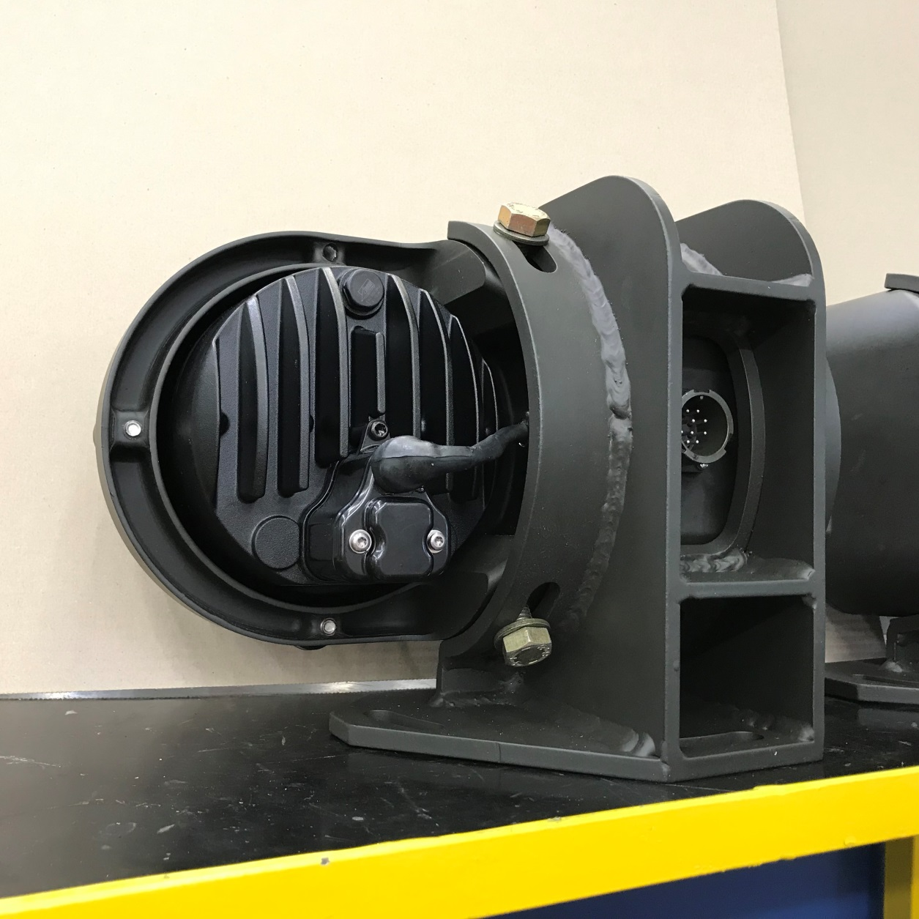
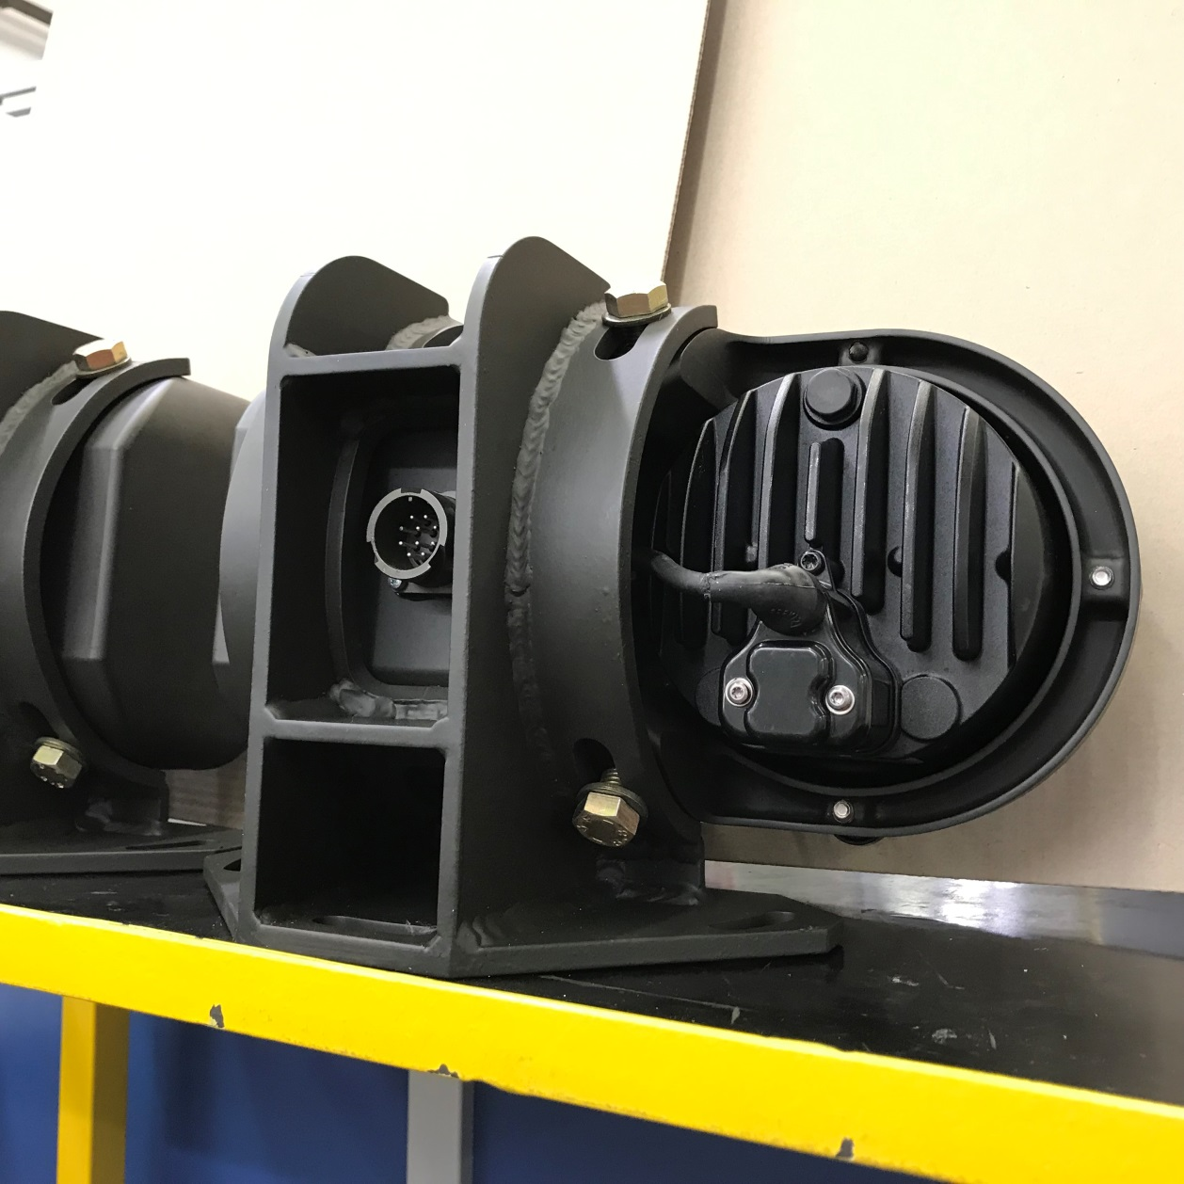
Pictures of the rear side, to better understand the combi - headlamp structure

Slide 7





Thank you
info@cobogroup.net | www.cobogroup.net

